Slide 1
Speed Up your iOS Development
Modules’s Paradigm

Slide 2
SUMMARY
Introduction
Most Used Patterns
How every single iOS App look internally
Modules are wonderful!
Tuning up your Views
Coding Time
Q&A

Slide 3



Introduction
About me:
https://github.com/fjtrujy
https://twitter.com/fjtrujy
https://medium.com/@fjtrujy

Slide 4
Introduction
Pieces of Advices
Based in my experience
Working alone/team
Development Speed
Testability
Reusability
Stability
Quality

Slide 5
Introduction - Most Used Patterns
MVC
MVP
MVVM
VIPER
…..
The one that I use?

Slide 6
Introduction - Most Used Patterns
Elements:
Model
View
Controller
Module
*Decorator
**Service

Slide 7
Introduction - Most Used Patterns
CMMVD
Elements:
Controller
Module
Model
View
*Decorator
**Service

Slide 8
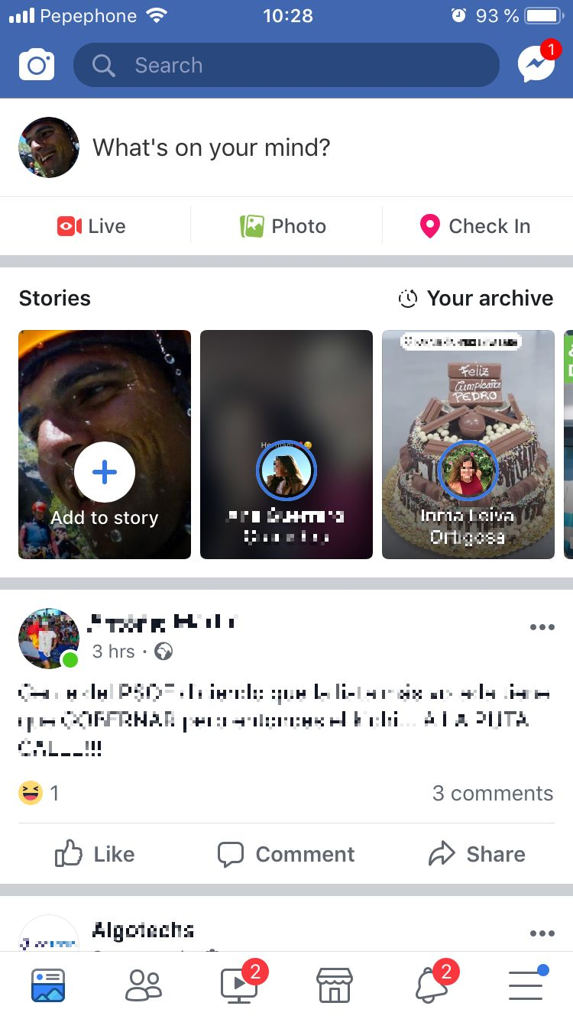
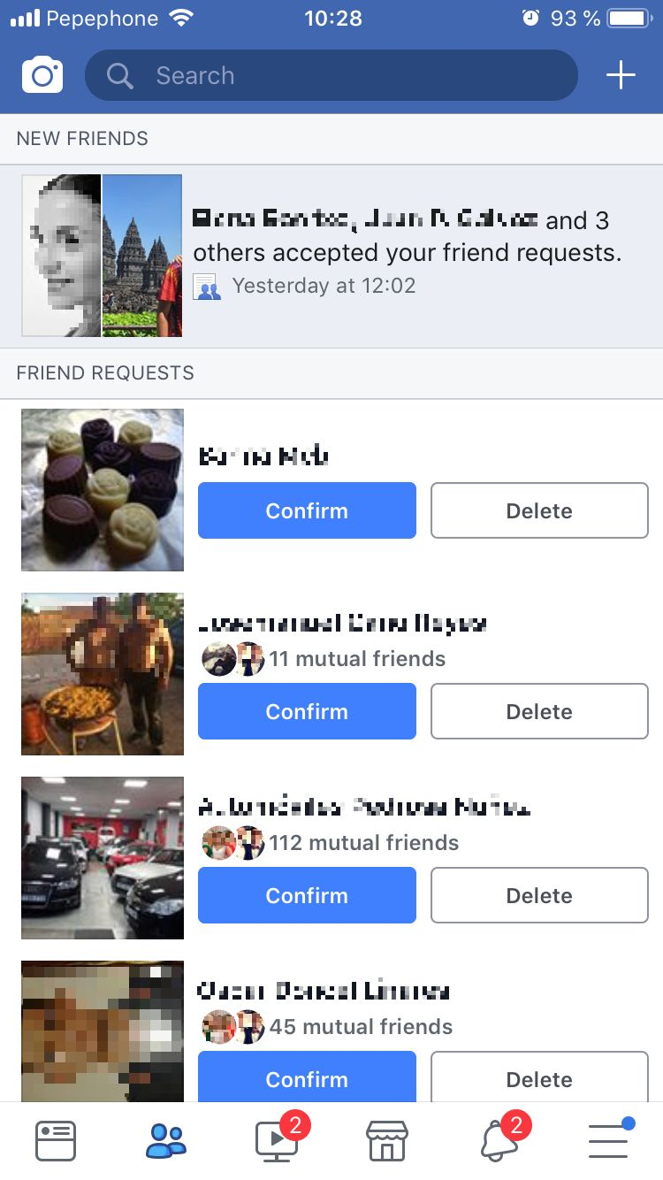
Introduction - How every single iOS App look internally

Slide 9

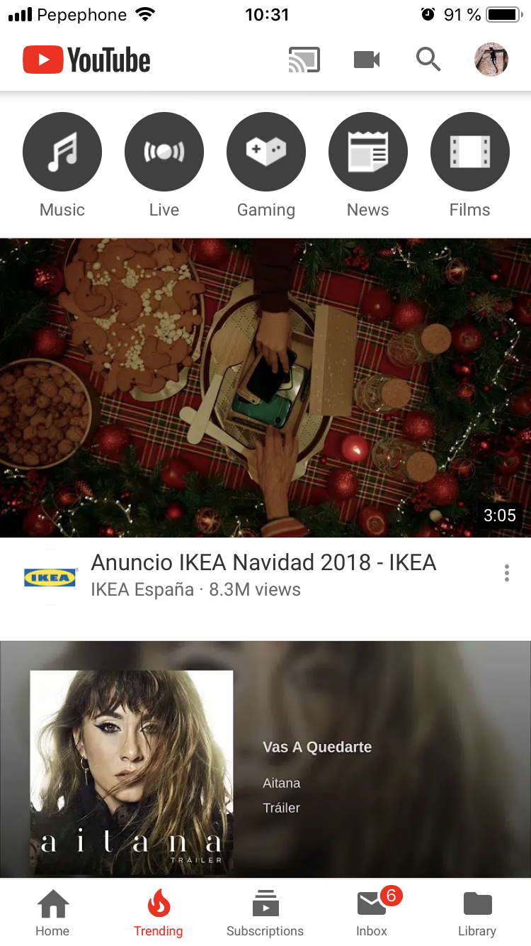
Introduction - How every single iOS App look internally

Slide 10

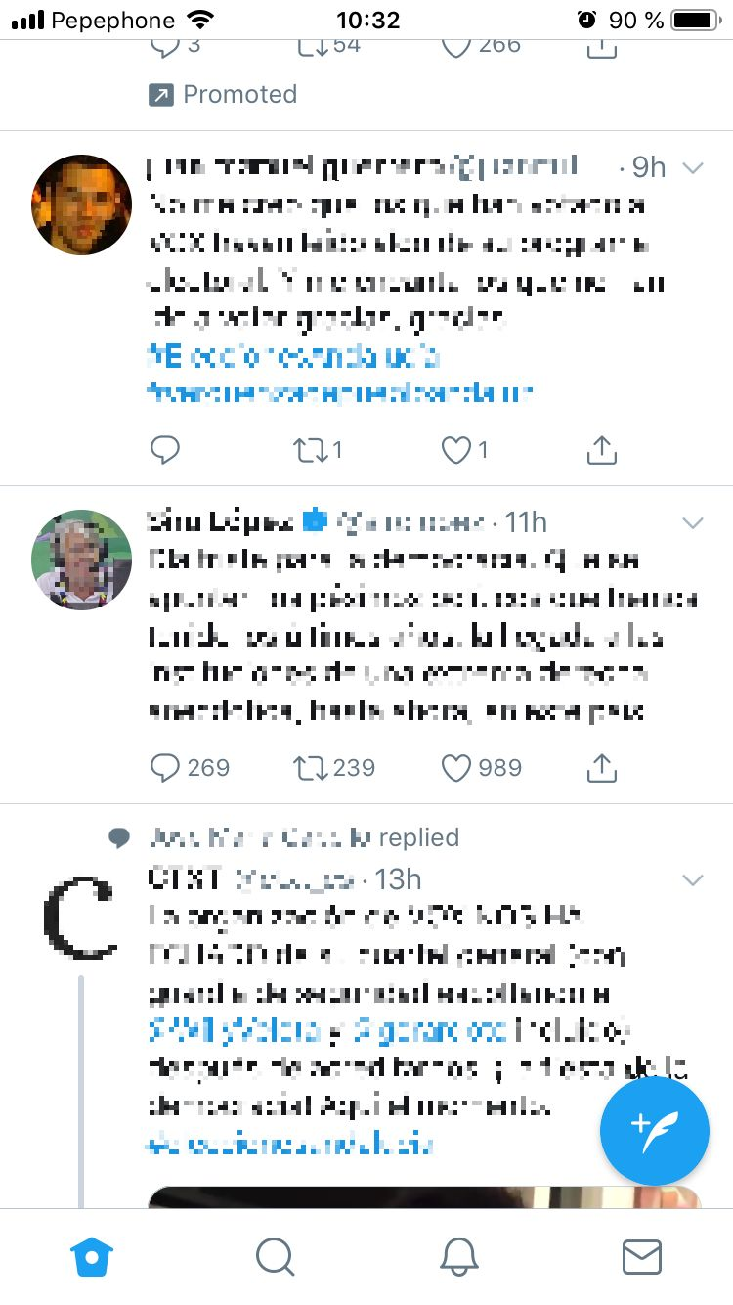
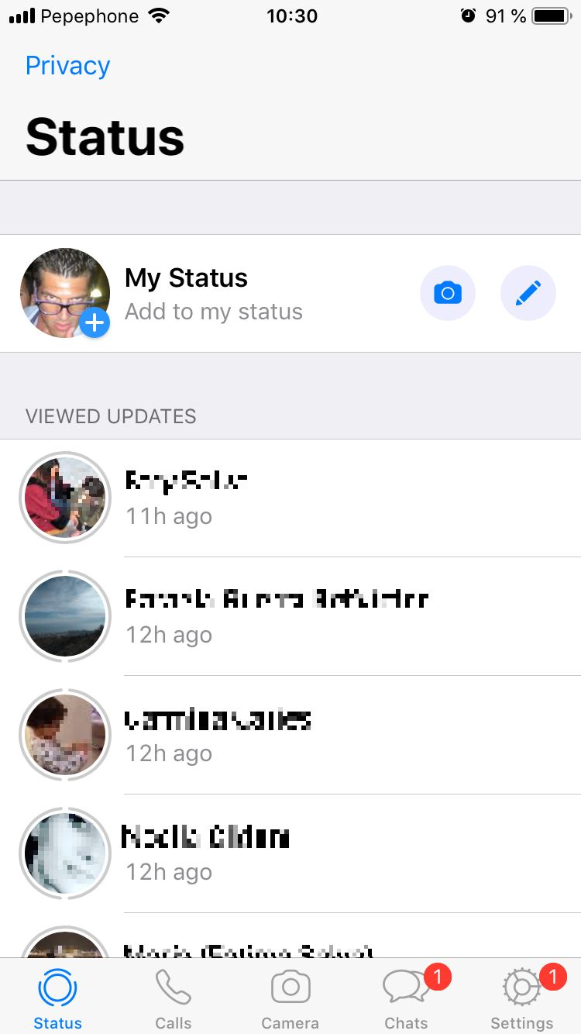
Introduction - How every single iOS App look internally

Slide 11
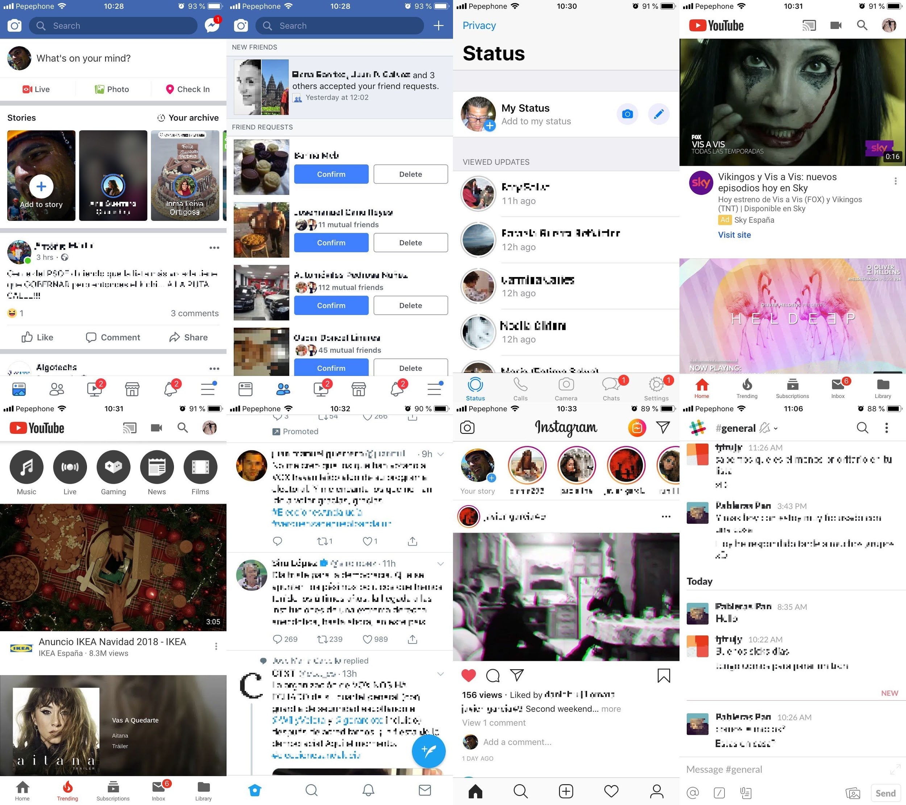
Introduction - How every single iOS App look internally
UITableViews

Slide 12
Introduction - How every single iOS App look internally
Sections:
Create new post
Stories
Post from your friends

Slide 13
Introduction - How every single iOS App look internally
Sections:
Stories
Post from your friends

Slide 14
Introduction - How every single iOS App look internally
Sections:
Post your Story
Stories from your friends
Recent Updates
Viewed

Slide 15
Introduction - How every single iOS App look internally
SECTION
=
MODULE

Slide 16
Modules are Wonderful!
A Module:
Is just a Powerful Section of a UITableView
Works as Isolated component
Is Reusable
Is Easy to extend
Is Scalable

Slide 17
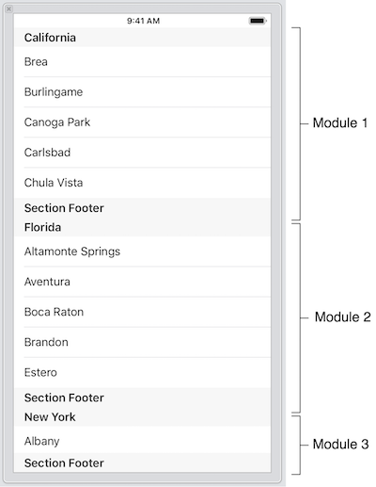
Modules are Wonderful!
Must see the apps as a collections of small components that could appear in any place.
If we want to reuse the “Module 1” in a different VC it should be as easiest as possible.
The VCs are composed by a list of Modules.

Slide 18
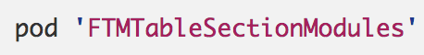
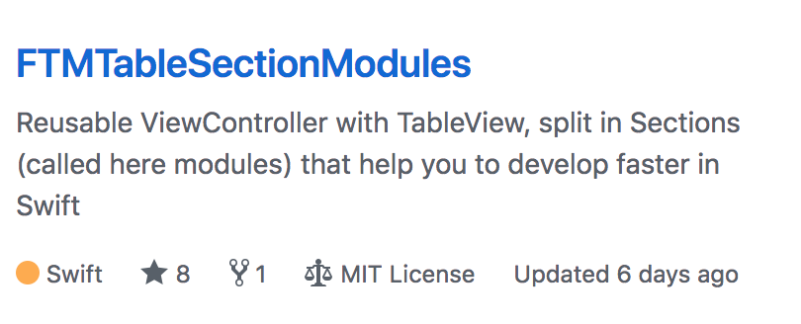
Modules are Wonderful!

Slide 19
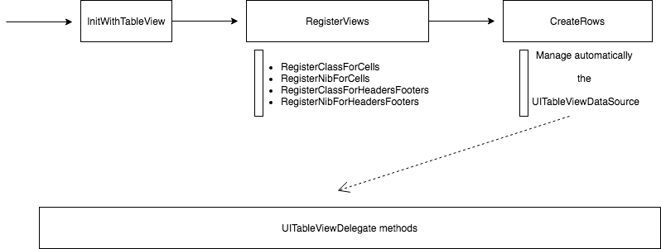
Modules are Wonderful!

Slide 20
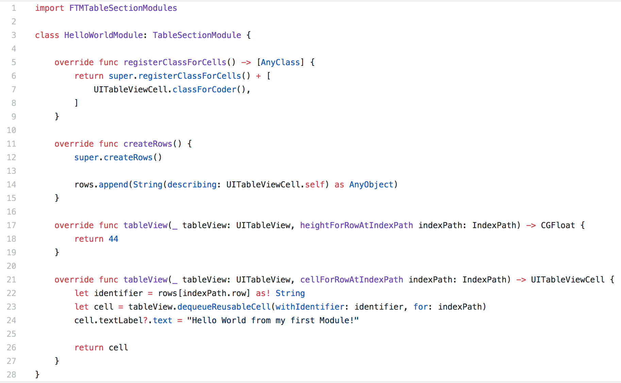
Modules are Wonderful!
Notes:
https://gist.github.com/fjtrujy/8ac8da7dc1e2d4deabce8963d103a0d0

Slide 21
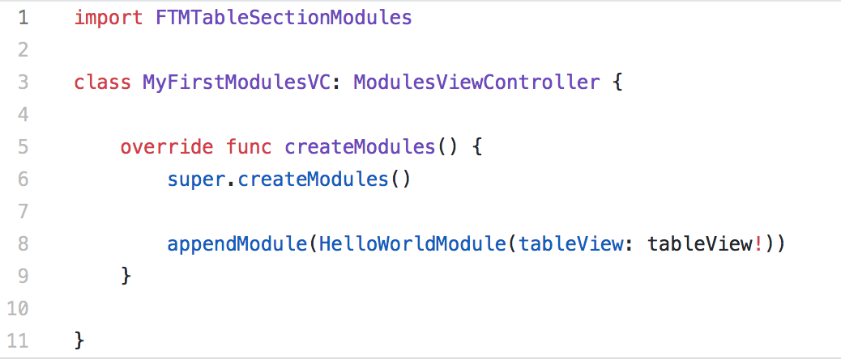
Modules are Wonderful!
Notes:
https://gist.github.com/fjtrujy/8c791346f406efe5ea19b3114cdf3492

Slide 22
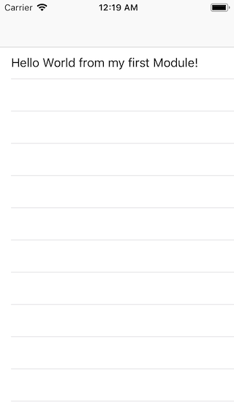
Modules are Wonderful!
Notes:
https://gist.github.com/fjtrujy/8c791346f406efe5ea19b3114cdf3492

Slide 23
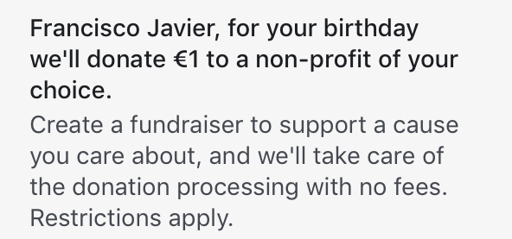
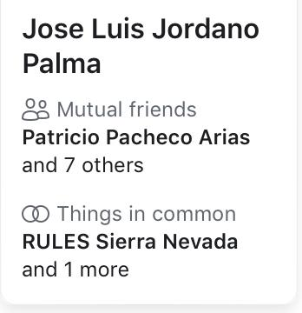

Tuning up your views!

Slide 24
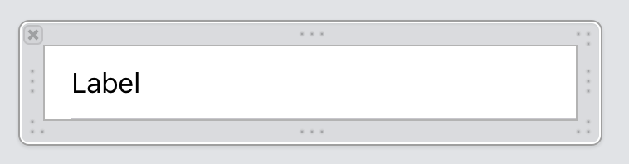
Tuning up your views!

Slide 25
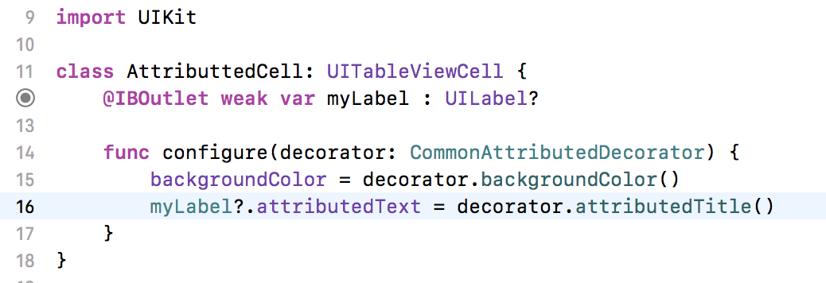
Tuning up your views!

Slide 26
Tuning up your views!
The Decorator is the key!
Don’t confuse with the Decorator Pattern
It works as ViewModel
Contains a lot of logic
Takes advantage of the NSAttributedString

Slide 27
Tuning up your views!
What are the view responsibilities:
Mainly defines subviews positions
Works with Autolayout
Asks the decorator how to “decorate” the view

Slide 28
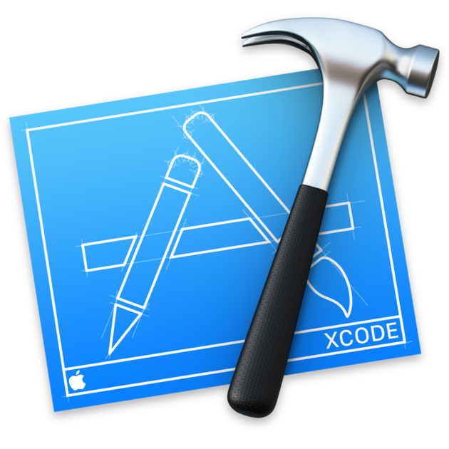
Coding Time

Slide 29

Q&A

Slide 30

THANKS

